Slide 1
PE3:CC & NLP Lab
1-Study and exploration of Natural Language Tool Kit (NLTK) in Python

Slide 2
Natural Language ToolKit (NLTK) and Python
Using NLTK in NLP
NL ToolKit provides libraries of many of the common NLP processes at various language levels
– Leverage these libraries to process text
Goal is to learn about and understand how NLP can be used to process text without programming all processes
– However, some programming is required to
• Call libraries
• Process data
• Customize NLP processes
– Programming language is Python

Slide 3
Natural Language ToolKit (NLTK) and Python
Python is freely available for many platforms from the Python Software Foundation:
– http://www.python.org/
– Named for the group Monty Python

Slide 4
Characteristics of Python
Easy-to-learn scripting language, similar in many aspects to Perl
– But with WYSIWYG block structure
Object-oriented, with modules, classes, exceptions, highlevel dynamic data types, similar to Java
Strongly typed, but without type declarations (dynamic typing)
Regular Expressions and other string processing features
High-level, general-purpose language
Readable code, clear syntax
Automatic garbage collection and memory management
Large standard library

Slide 5
Natural Language Toolkit (NLTK)
Python package that implements many standard NLP data structures, algorithms
A suite of Python libraries for symbolic and statistical natural language programming
– Developed in 2001 at the University of Pennsylvania
– Authors: Edward Loper, Ewan Kline and Steven Bird and Many contributors
• Developed to be a teaching tool and a platform for research NLP prototypes
– Data types are packaged as classes
– Goal of code is to be clear, rather than fastest performance
• Open-source • http://www.nltk.org
–Documentation also at this address
Online book: http://www.nltk.org/book/

Slide 6
Getting Started in Python
• Python can be run as an interactive system
– Type in expressions or small pieces of programs to try them out
• or as a command-line system.
– Run stored python programs
• For both, it is recommended to use IDLE, the Python development environment
– Especially good to edit Python programs in IDLE to keep track of the indentation for block structure

Slide 7
Introduction to NLTK
• NLTK provides:
Basic classes for representing data relevant to Natural Language Processing.
Standard interfaces for performing NLP tasks such as tokenization, tagging and parsing
Standard implementation of each task which can be combined to solve complex problems

Slide 8
NLTK Modules
• corpora: a package containing modules of example text
• tokenize: functions to separate text strings
• probability: for modeling frequency distributions and probabilistic systems
• stem – package of functions to stem words of text
• wordnet – interface to the WordNet lexical resource
• chunk – identify short non-nested phrases in text
• etree: for hierarchical structure over text
• tag: tagging each word with part-of-speech, sense, etc.
• parse: building trees over text - recursive descent, shift-reduce, probabilistic, etc.
• cluster: clustering algorithms
• draw: visualize NLP structures and processes
• contrib: various pieces of software from outside contributors

Slide 9
NLTK Modules
Language Processing Task | NLTK module | Some functionalities
Accessing corpora | nltk.corpus | Standardized interfaces to corpora and lexicons
String processing | nltk.tokenize | Sentence and word tokenizers
 | nltk.stem | Stemmers
Part-of-speech tagging | nltk.tag | Various part-of-speech taggers
Classification | nltk.classify | Decision tree, maximum entropy
 | nltk.cluster | K-means
Chunking | nltk.chunk | Regular expressions, named entity tagging

Slide 10
Python/NLTK installation steps
Install Python 3.8: http://www.python.org/downloads/ (avoid the 64-bit versions)
Install Numpy (optional): https://www.scipy.org/scipylib/download.html
Install NLTK: http://pypi.python.org/pypi/nltk
Test installation: Start>Python38, then type import nltk

Slide 11
Python/NLTK Versions
• We will use:
• Python 3.7
• NLTK 3.
Importing NLTK
pip install nltk
conda install -c anaconda nltk
>>> import nltk
Downloading NLTK’s Data
>>> nltk.download()

Slide 12
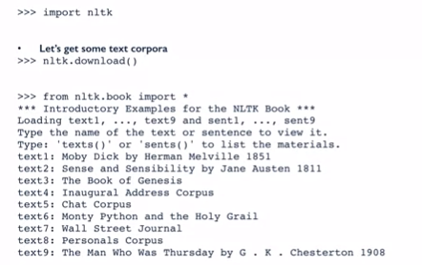
NLTK

Slide 13
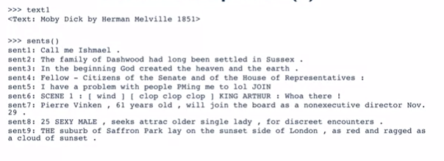
NLTK Corpus

Slide 14
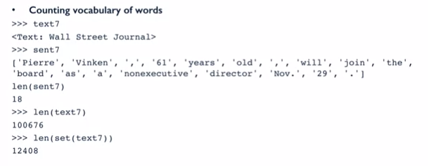
Simple NLTK Task

Slide 15
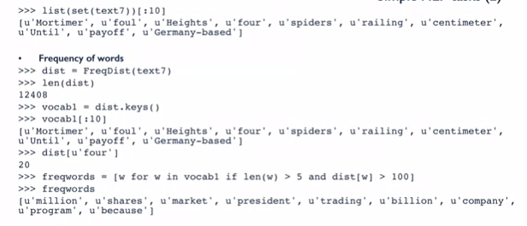
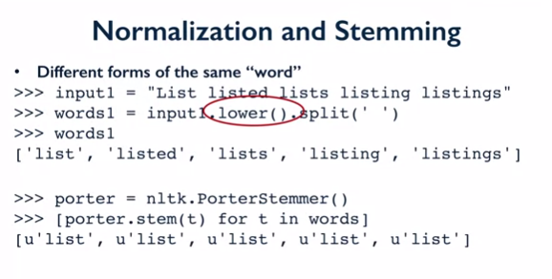
Simple NLTK Task

Slide 16
Getting Started: Corpora
• Task: Accessing corpora
• NLTK module: nltk.corpus
• Functionality: standardized interfaces to corpora and lexicons
• Example:
>>> from nltk.corpus import gutenberg
>>> gutenberg.fileids()
>>> hamlet = gutenberg.words('shakespeare-hamlet.txt')
>>> hamlet[1:100]
• Also: Brown, Reuters, chats, reviews, etc.

Slide 17
Getting Started: String Processing
• Task: string processing
• NLTK module: nltk.tokenize, nltk.stem
• Functionality: word tokenizers, sentence tokenizers, stemmers
• Example:
>>> text = nltk.word_tokenize("The quick brown fox jumps over the lazy dog")
>>> text = nltk.sent_tokenize("The quick brown fox jumps over the lazy dog. What a lazy dog!")
>>> from nltk.stem.wordnet import WordNetLemmatizer
>>> WordNetLemmatizer().lemmatize(’dogs’,’n’)
>>> WordNetLemmatizer().lemmatize(’jumps’,’v’)
>>> import nltk
>>> sentence = """At eight o'clock on Thursday morning.. Arthur didn't feel very good."""
>>> tokens = nltk.word_tokenize(sentence)
>>> tokens
['At', 'eight', "o'clock", 'on', 'Thursday', 'morning',
'Arthur', 'did', "n't", 'feel', 'very', 'good', '.']
>>> tagged = nltk.pos_tag(tokens)
>>> tagged[0:6]
[('At', 'IN'), ('eight', 'CD'), ("o'clock", 'JJ'), ('on', 'IN'),
('Thursday', 'NNP'), ('morning', 'NN')]

Slide 18
Getting Started: Tokenization
•Process of breaking the given text i.e. the character sequence into smaller units called tokens.
The tokens may be the words, numbers or punctuation marks. It is also called word segmentation
The ending of a word and the beginning of a new word are called word boundaries.
Different packages related to tokenization which we can use to divide the text into tokens as per our requirements.

Slide 19
Getting Started: Tokenization
word_tokenize package- divides the input text into words.
from nltk.tokenize import word_tokenize
WordPunctTokenizer package- divides the input text into words as well as the punctuation marks.
from nltk.tokenize import WordPuncttokenizer
sent_tokenize package- this package will divide the input text into sentences.
from nltk.tokenize import sent_tokenize

Slide 20
Getting Started: Stemming
A lot of variations of words due to grammatical reasons.
The concept of variations here means that to deal with different forms of the same words like democracy, democratic, and democratization.
Necessary for machines to understand that these different words have the same base form.
Useful to extract the base forms of the words while analyzing the text.
Can be achieve this by stemming.
Stemming is the heuristic process of extracting the base forms of the words by chopping off the ends of words.

Slide 21
Getting Started: Stemming
PorterStemmer package- uses the Porter’s algorithm to extract the base form.
from nltk.stem.porter import PorterStemmer
LancasterStemmer package- uses the Lancaster’s algorithm to extract the base form.
from nltk.stem.lancaster import LancasterStemmer
SnowballStemmer package- uses the snowball’s algorithm to extract the base form.
from nltk.stem.snowball import SnowballStemmer
Notes:
All of these algorithms have different level of strictness. If we compare these three stemmers then the Porter stemmers is the least strict and Lancaster is the strictest. Snowball stemmer is good to use in terms of speed as well as strictness.

Slide 23
Getting Started: Lemmatization
Also extract the base form of words by lemmatization.
Task with the use of a vocabulary and morphological analysis of words, normally aiming to remove inflectional endings only.
This kind of base form of any word is called lemma.
Difference between stemming and lemmatization is the use of vocabulary and morphological analysis of the words.
Another difference is that stemming most commonly collapses derivationally related words whereas lemmatization commonly only collapses the different inflectional forms of a lemma.
For example, if we provide the word saw as the input word then stemming might return the word ‘s’ but lemmatization would attempt to return the word either see or saw depending on whether the use of the token was a verb or a noun.

Slide 24
Getting Started: Lemmatization
WordNetLemmatizer package- extract the base form of the word depending upon whether it is used as a noun or as a verb.
from nltk.stem import WordNetLemmatizer
Notes:
All of these algorithms have different level of strictness. If we compare these three stemmers then the Porter stemmers is the least strict and Lancaster is the strictest. Snowball stemmer is good to use in terms of speed as well as strictness.

Slide 25
Getting Started: Part-of-Speech Tagging
• Task: Part-of-Speech Tagging
• NLTK module: nltk.tag
• Functionality: Brill, HMM, TnT taggers
• Example:
>>> text = nltk.word_tokenize(“It was the best of times, it was the worst of times.”)
>>> nltk.pos_tag(text)

